Slide 1
Project 1 Disease Prediction
PPT OF PROJECT
import pandas as pd
from sklearn.model_selection import train_test_split
from sklearn.preprocessing import StandardScaler from sklearn.linear_model import LogisticRegression
from sklearn.metrics import accuracy_score, confusion_matrix, classification_report
data = pd.read_csv('/content/test_data (1).csv
')
print(data.head()) print(data.info()) print(data.describe()) data = data.dropna()
X = data.drop('Disease', axis=1) y = data['Disease'] scaler = StandardScaler()
X_scaled = scaler.fit_transform(X)
X_train, X_test, y_train, y_test = train_test_split(X_scaled, y, test_size=0.2, random_state=42)
model = LogisticRegression()
model.fit(X_train, y_train) y_pred = model.predict(X_test)
accuracy = accuracy_score(y_test, y_pred) print(f'Accuracy: {accuracy}')
cm = confusion_matrix(y_test, y_pred)
print(f'Confusion Matrix:\n{cm}')
report = classification_report(y_test, y_pred)

Slide 2
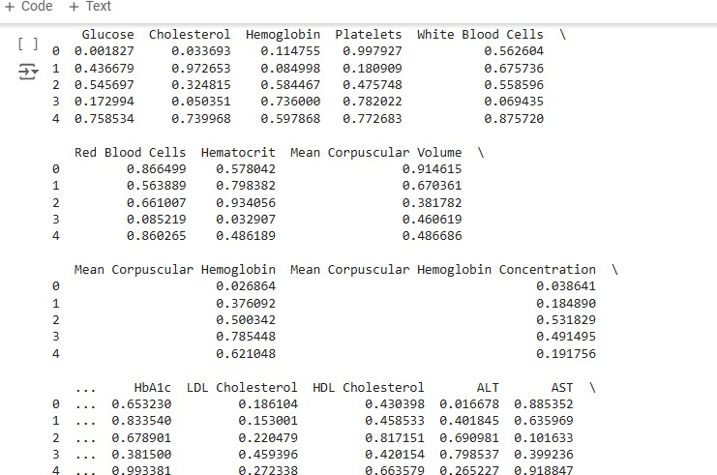
print(f'Classification Report:\n{report}')
coefficients = model.coef_ print(f'Coefficients:\n{coefficients}')
OUTPUT:

Slide 3
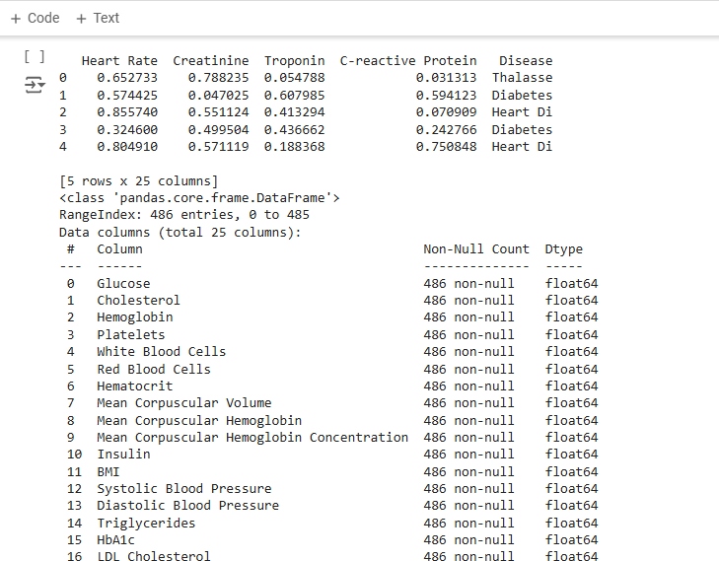
#LOGISTIC REGRESSION
import pandas as pd
from sklearn.model_selection import train_test_split from sklearn.preprocessing import StandardScaler from sklearn.linear_model import LogisticRegression
from sklearn.metrics import accuracy_score, precision_score, recall_score, f1_score, confusion_matrix
# Step 1: Load your data
data = pd.read_csv('/content/test_data (1).csv')
# Step 2: Preprocess the data
# Assuming no missing values and all columns are numerical or have been encoded appropriately # If there are categorical variables, use pd.get_dummies() or other encoding techniques
# Separate features and target
X = data.drop(columns=['Disease']) # Replace 'target' with the name of your target column y = data['Disease']

Slide 4
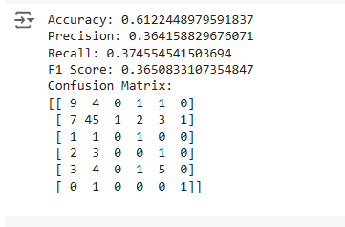
# Normalize/Scale the features scaler = StandardScaler()
X_scaled = scaler.fit_transform(X)
# Step 3: Split the data into training and testing sets
X_train, X_test, y_train, y_test = train_test_split(X_scaled, y, test_size=0.2, random_state=0)
# Step 4: Train a classification model (Logistic Regression as an example) model = LogisticRegression()
model.fit(X_train, y_train)
# Step 5: Evaluate the model y_pred = model.predict(X_test)
accuracy = accuracy_score(y_test, y_pred)
precision = precision_score(y_test, y_pred, average='macro') 'weighted' for multi-class
recall = recall_score(y_test, y_pred, average='macro') 'weighted' for multi-class
f1 = f1_score(y_test, y_pred, average='macro')
# Use 'macro', 'micro', or
# Use 'macro', 'micro', or
print(f'Accuracy: {accuracy}') print(f'Precision: {precision}') print(f'Recall: {recall}') print(f'F1 Score: {f1}')
# Optionally, display the confusion matrix conf_matrix = confusion_matrix(y_test, y_pred) print('Confusion Matrix:')
print(conf_matrix)
OUTPUT:
#RANDOM FOREST
import pandas as pd

Slide 5
from sklearn.model_selection import train_test_split from sklearn.preprocessing import StandardScaler from sklearn.ensemble import RandomForestClassifier
from sklearn.metrics import accuracy_score, precision_score, recall_score, f1_score, confusion_matrix
# Step 1: Load your data
data = pd.read_csv('/content/test_data (1).csv')
# Step 2: Preprocess the data
# Assuming no missing values and all columns are numerical or have been encoded appropriately # If there are categorical variables, use pd.get_dummies() or other encoding techniques
# Separate features and target
X = data.drop(columns=['Disease']) # Replace 'target' with the name of your target column y = data['Disease']
# Normalize/Scale the features scaler = StandardScaler()
X_scaled = scaler.fit_transform(X)
# Step 3: Split the data into training and testing sets
X_train, X_test, y_train, y_test = train_test_split(X_scaled, y, test_size=0.2, random_state=0)
# Step 4: Train a Random Forest classifier
model = RandomForestClassifier(n_estimators=100, random_state=0) model.fit(X_train, y_train)
# Step 5: Evaluate the model y_pred = model.predict(X_test)
accuracy = accuracy_score(y_test, y_pred)
precision = precision_score(y_test, y_pred, average='macro') recall = recall_score(y_test, y_pred, average='macro')
f1 = f1_score(y_test, y_pred, average='macro')
# Changed to 'macro' # Changed to 'macro' # Changed to 'macro'
print(f'Accuracy: {accuracy}') print(f'Precision: {precision}') print(f'Recall: {recall}') print(f'F1 Score: {f1}')
# Optionally, display the confusion matrix conf_matrix = confusion_matrix(y_test, y_pred) print('Confusion Matrix:')
print(conf_matrix)
OUTPUT:

Slide 6
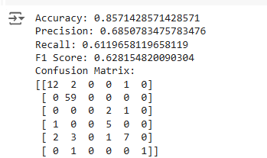
#DECISION TREE
import pandas as pd
from sklearn.model_selection import train_test_split
from sklearn.preprocessing import StandardScaler from sklearn.tree import DecisionTreeClassifier
from sklearn.metrics import accuracy_score, precision_score, recall_score, f1_score, confusion_matrix
# Step 1: Load your data
data = pd.read_csv('/content/test_data (1).csv')
# Step 2: Preprocess the data
# Assuming no missing values and all columns are numerical or have been encoded appropriately # If there are categorical variables, use pd.get_dummies() or other encoding techniques
# Separate features and target
X = data.drop(columns=['Disease']) # Replace 'target' with the name of your target column y = data['Disease']
# Normalize/Scale the features scaler = StandardScaler()
X_scaled = scaler.fit_transform(X)
# Step 3: Split the data into training and testing sets
X_train, X_test, y_train, y_test = train_test_split(X_scaled, y, test_size=0.2, random_state=0)
# Step 4: Train a Decision Tree classifier model = DecisionTreeClassifier(random_state=0) model.fit(X_train, y_train)
# Step 5: Evaluate the model y_pred = model.predict(X_test)
accuracy = accuracy_score(y_test, y_pred)
precision = precision_score(y_test, y_pred, average='macro') # Changed to 'macro'

Slide 7
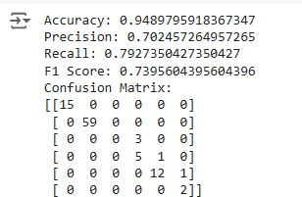
recall = recall_score(y_test, y_pred, average='macro') f1 = f1_score(y_test, y_pred, average='macro')
# Changed to 'macro' # Changed to 'macro'
print(f'Accuracy: {accuracy}') print(f'Precision: {precision}') print(f'Recall: {recall}') print(f'F1 Score: {f1}')
# Optionally, display the confusion matrix conf_matrix = confusion_matrix(y_test, y_pred) print('Confusion Matrix:')
print(conf_matrix)
OUTPUT:
#Support Vector Machines (SVM):
#Naive Bayes:
#K-Nearest Neighbors (KNN): #Neural Networks:
#Gradient Boosting Machines:
import pandas as pd
from sklearn.model_selection import train_test_split
from sklearn.preprocessing import StandardScaler from sklearn.svm import SVC
from sklearn.naive_bayes import GaussianNB
from sklearn.neighbors import KNeighborsClassifier from sklearn.neural_network import MLPClassifier
from sklearn.ensemble import GradientBoostingClassifier
from sklearn.metrics import accuracy_score, precision_score, recall_score, f1_score, confusion_matrix

Slide 8
# Step 1: Load your data
data = pd.read_csv('/content/test_data (1).csv') # Ensure your file is in the same directory or provide the correct path
# Step 2: Preprocess the data
# Assuming no missing values and all columns are numerical or have been encoded appropriately
# Separate features and target
X = data.drop(columns=['Disease']) # Replace 'Disease' with the name of your target column y = data['Disease']
# Normalize/Scale the features scaler = StandardScaler()
X_scaled = scaler.fit_transform(X)
# Step 3: Split the data into training and testing sets
X_train, X_test, y_train, y_test = train_test_split(X_scaled, y, test_size=0.2, random_state=0)
# Define models models = {
'Support Vector Machine': SVC(random_state=0), 'Naive Bayes': GaussianNB(),
'K-Nearest Neighbors': KNeighborsClassifier(),
'Neural Network': MLPClassifier(random_state=0, max_iter=300), 'Gradient Boosting': GradientBoostingClassifier(random_state=0)
}
# Train and evaluate each model results = []
conf_matrices = {}
for name, model in models.items(): model.fit(X_train, y_train) y_pred = model.predict(X_test)
accuracy = accuracy_score(y_test, y_pred)
precision = precision_score(y_test, y_pred, average='macro') recall = recall_score(y_test, y_pred, average='macro')
f1 = f1_score(y_test, y_pred, average='macro') results.append({
'Model': name,
'Accuracy': accuracy, 'Precision': precision, 'Recall': recall,
'F1 Score': f1
})
conf_matrices[name] = confusion_matrix(y_test, y_pred)

Slide 9
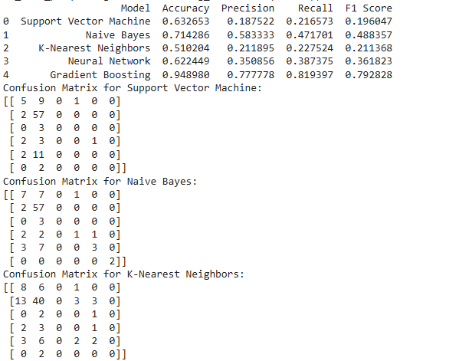
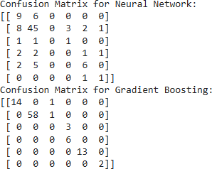
results_df = pd.DataFrame(results)
# Displaying the results and confusion matrices print(results_df)
for name, conf_matrix in conf_matrices.items():
print(f'Confusion Matrix for {name}:') print(conf_matrix)
OUTPUT:

Slide 10
